Slide 1
Programming 4 - Intermediate Architecture
and Algorithms
Functional Programming with Python II
Semester 1, 2019

Slide 2
Last session
Functions as objects – first class objects/citizens
Assignment functions to variables
Passing and return functions
Callbacks
Higher-order functions such as map, filter, reduce and closures
Lambda functions

Slide 3
This session
List comprehensions
Iterators
Generators
Decorators

Slide 4
List comprehensions
A more succinct syntax for map(fn1, filter(fn2, sequence))
[epression for variableName in iterable conditional]
expression – a mathematical equation or function
variableName – a placeholder, as in a foreach loop
iterable – any collection that has a next function
conditional – a filter on the items in the collection
Returns a new list containing all the results
Notes:
Note expression can be an expression, function or lambda function
Sequences like lists and tuples have next as part of their class definitions, so they can be used in list comprehensions

Slide 5
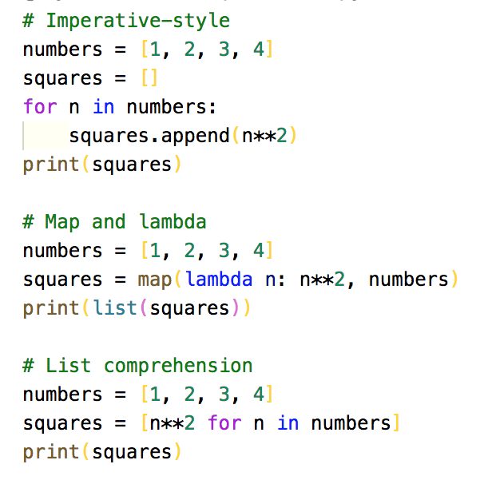
List comprehensions
Imperative-style
Map
List comprehension
Notes:
Logically, the are equivalent. Although, recall that map actually returns a different data type that must be cast to a list for printing
As the computations get more complicated, the list comprehension becomes increasingly more succinct than the imperative and map approach

Slide 6
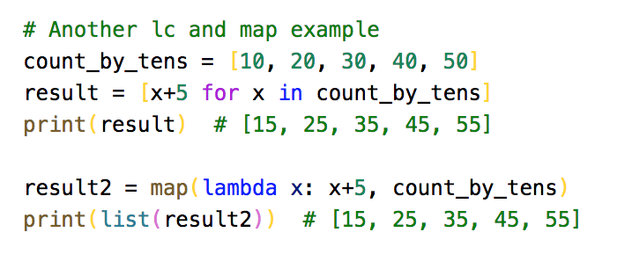
List comprehensions
Doesn’t have to be a complete function definition like lambda
There can sometimes be a performance advantage
Considered idiomatic Python
Notes:
We would need to use a function like map to do the same thing
There can be sometimes be a performance advantage for using one over the other, depending on the exact nature of the function and collection
List comprehensions are preferred because they are considered idiomatic Python

Slide 7
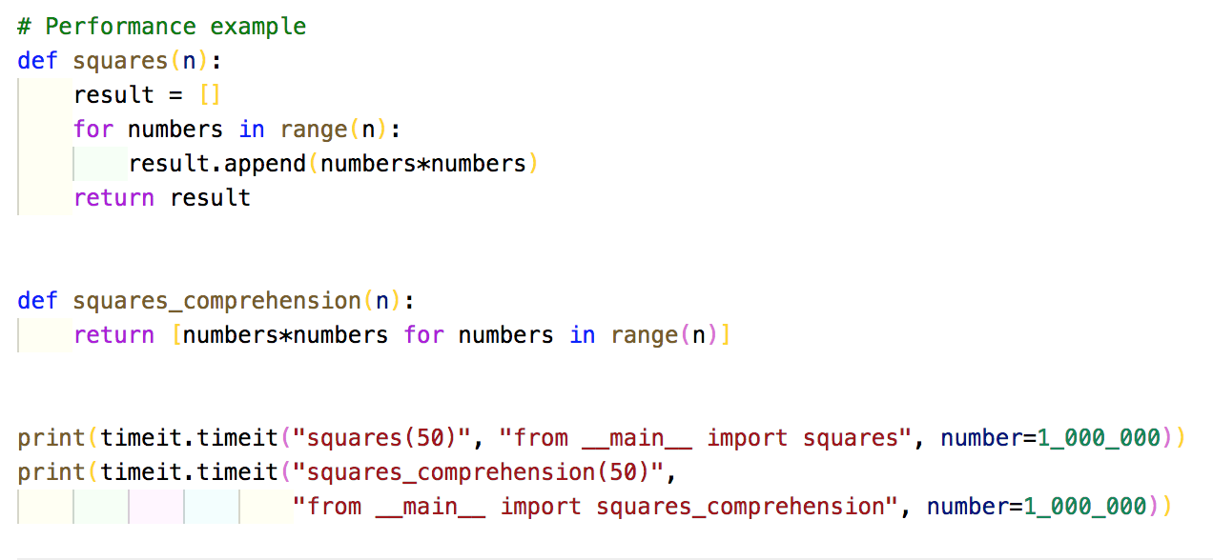
List comprehensions
List comprehension are significantly faster than imperative-style
Notes:
Imperative-style = 6.143417131
List comprehension = 3.539589169000001

Slide 8
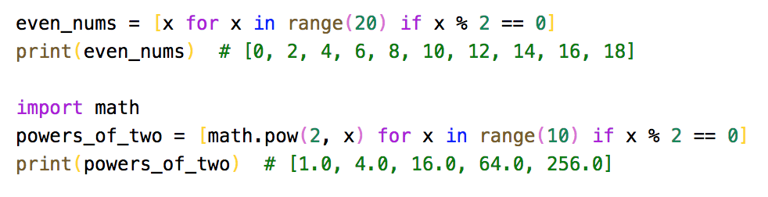
List comprehensions
Conditional filtering
Libraries can used with in the list comprehension
Notes:
Expressions can be any function. Here we use the exponentiation function from the Python math library
The result returns a list of floats. We can wrap math.pow with math.trunc to return a list of integers instead

Slide 9
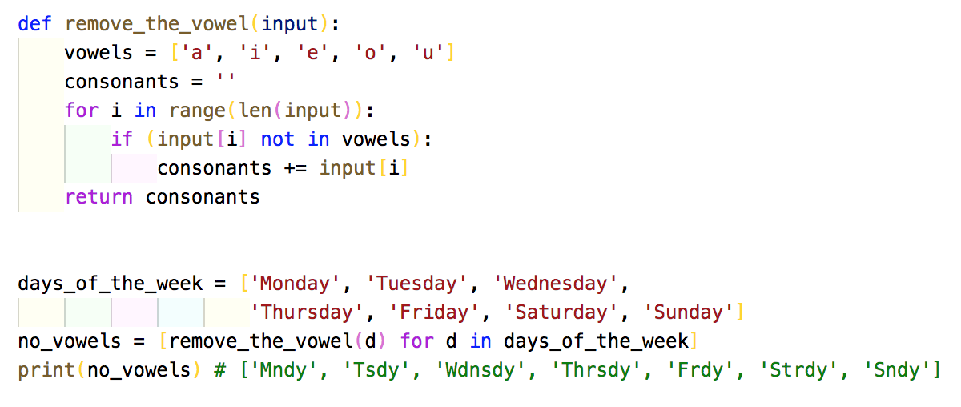
List comprehensions

Slide 10
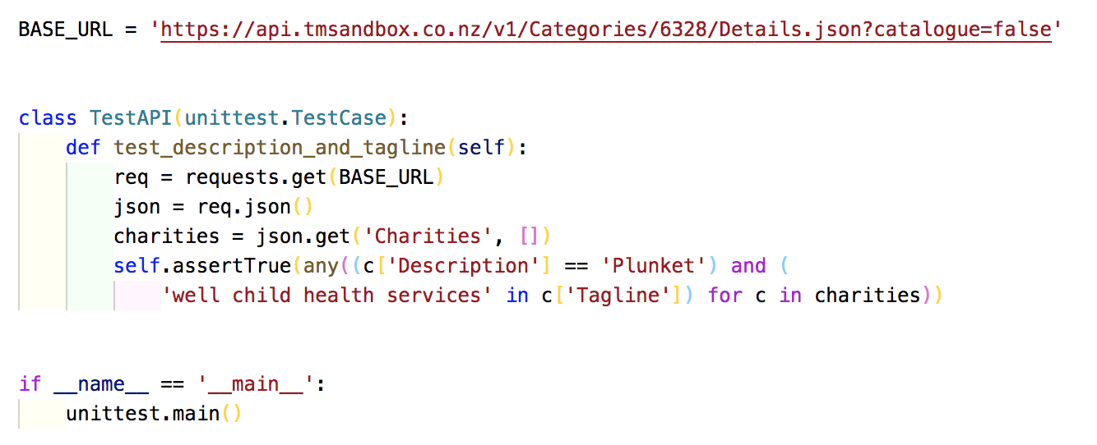
List comprehensions
Unit testing

Slide 11
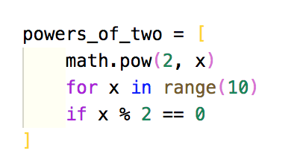
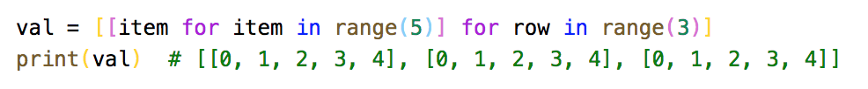
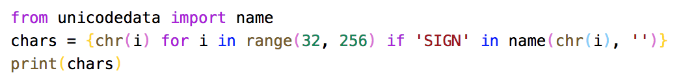
List comprehensions
Nested list comprehensions
Returns a list of lists / 2D array in other languages
Notes:
List comprehensions are found in various languages such as JavaScript, R, Ruby and Scheme. Of course there are plenty more…
You can also do dictionary and set comprehensions
List comprehensions can be less readable due to limited amounts of white space. Imperative-style uses indentations making it easier to read but more lines of code
If you find one liners difficult, list compressions allow line breaks

Slide 12

When to use list comprehensions
Do not call functions with side effects – print()
Don’t use except for making lists
Should be only used for turning one list or iterable into another list

Slide 13
Iterators
Can be iterated over
Can be processed one element at a time
To make an iterable class
Define method __iter__ which returns the instance
Define method __next__ which returns the relevant element, one at a time, on repeat calls
When all items have been given, raise the StopIteration exception
Notes:
You will note that a list comprehension requires something that is iterable such as a list, tuple (immutable), string and dictionary

Slide 14
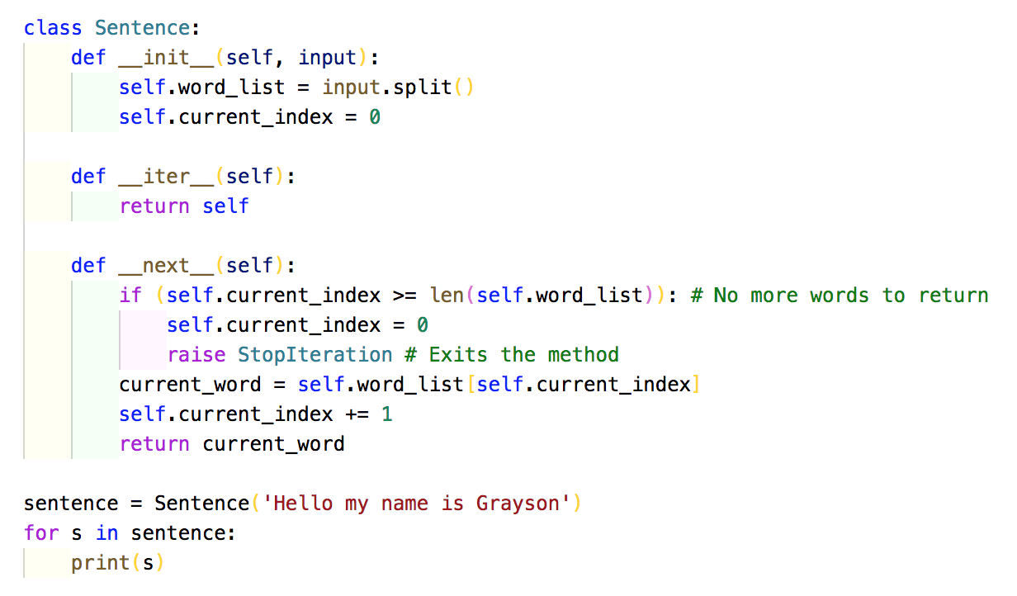
Iterators
Notes:
Assume we want to write a class that makes sentences into an iterable set of words
Note you can already do this by using split()
Our plan is to take the input and convert it into a list of words with split()
We will keep an index counter that goes through the list
Each time __next__ is called, we update the counter and either return the word or exit

Slide 15
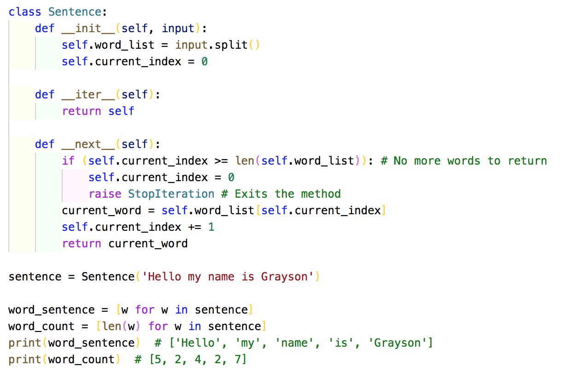
Iterators
Notes:
Note that you don’t see any exception is being thrown. It’s not treated as an error in this case. It’s more like an event, and the for loop knows that it means “stop looping”

Slide 16
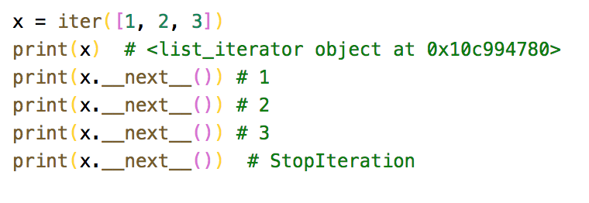
Iterators
Built in function iter takes a sequence and returns an iterator
Each time we call the next method on the iterator gives us the next element
If there are no more elements, it raises a StopIteration

Slide 17
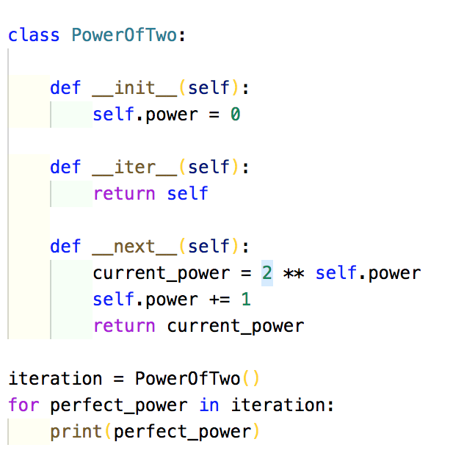
Iterators

Slide 18
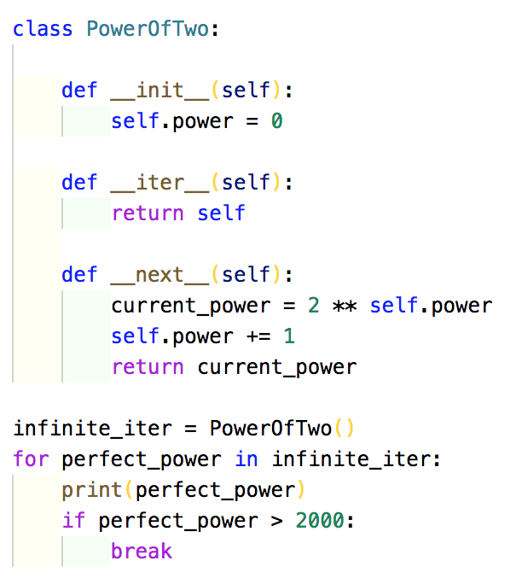
Infinite iterators
Is it our reponsiblility to break out
__next__ never raises StopIteration

Slide 19
Generators
A special kind of function that is iterable
Generators do not exit when they return a value, they simply pause
The next time they are called, they pick up where they left off
They use yield rather than return
Notes:
The keyword yield is used to pause and save the internal state of a value when it is returned

Slide 20
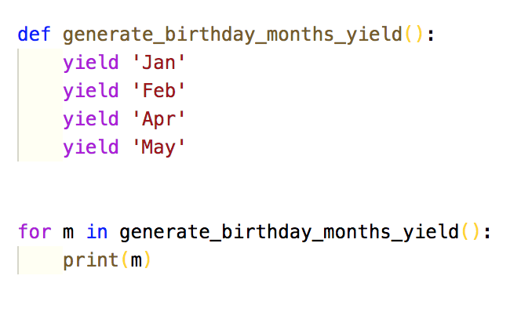
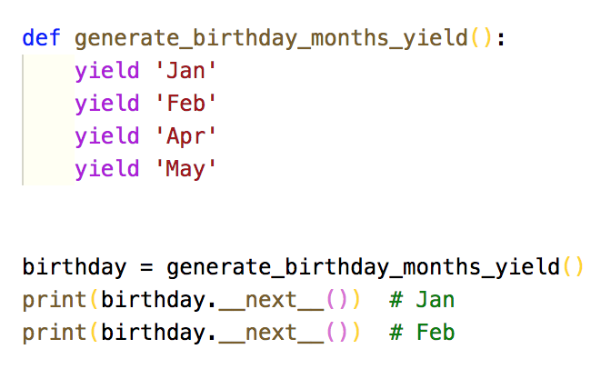
Generators
Each yield returns a value and pauses
Be careful with __next__()
The yield command defines the next function
StopIteration is treated as an exception
Notes:
Make sure when you are creating a generator instance, you assign it to a variable – creates local storage
Just calling the method doesn't’t do that – no local storage, yield and pause

Slide 21
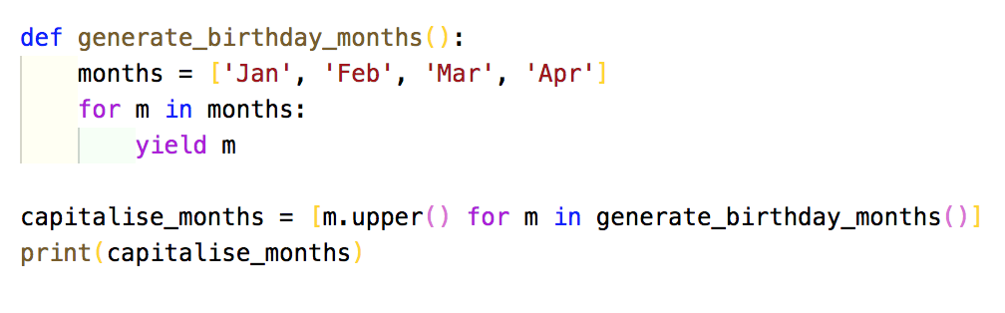
Generators
Yield inside a for loop
Using generator object in a list comprehension

Slide 22
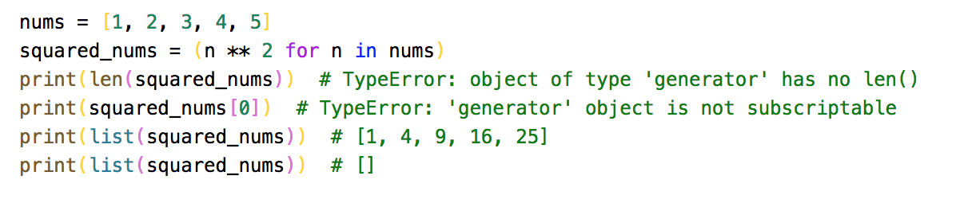
Generators expressions
If you change your list comprehension from [] to () – generator expression
Doesn’t know its length
Can’t index
Single use iterable
Notes:
Once it has looped through all elements, it is exhausted – empty list

Slide 23
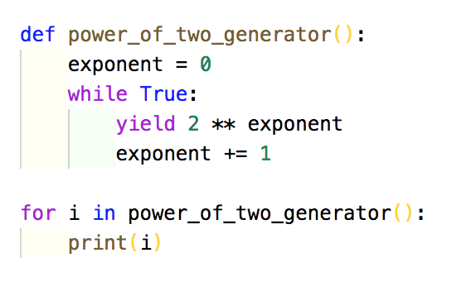
Infinite generators
Like infinite iterators, there are infinite generators

Slide 24
Decorators
Brief – you will look more into this in the later programming papers
Callable objects which are used to modify functions or classes
Function decorators:
Accepts a function as an argument
Adds a wrapper around the function
Returns the wrapped function as new function

Slide 25
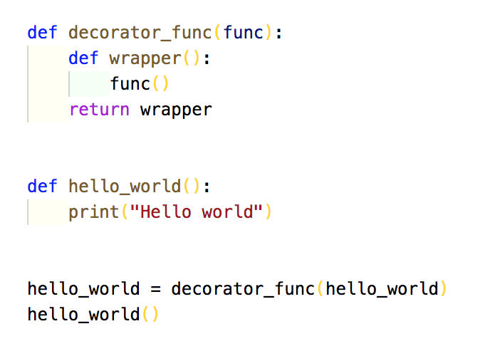
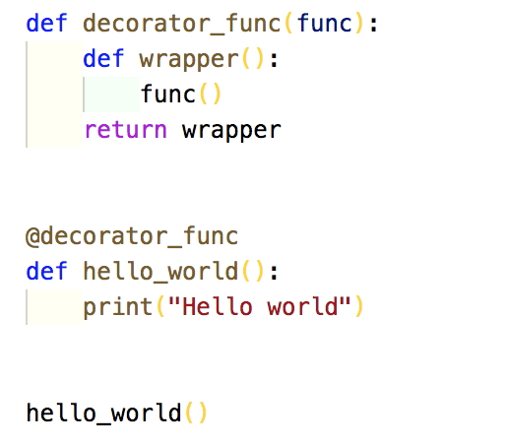
Decorators

